Slide 1
ARXIV DATASET

Slide 2
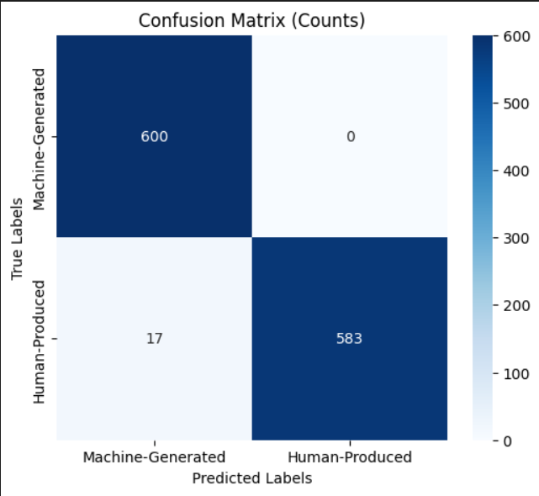
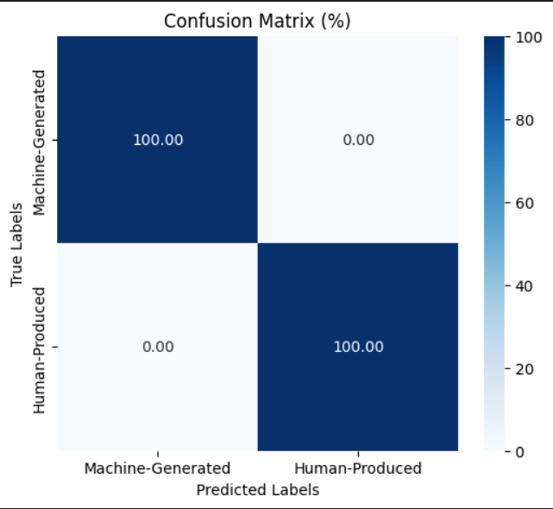
Pretrained Model
Chatgpt Dataset
Finetuned Model
Chatgpt Dataset

Slide 3
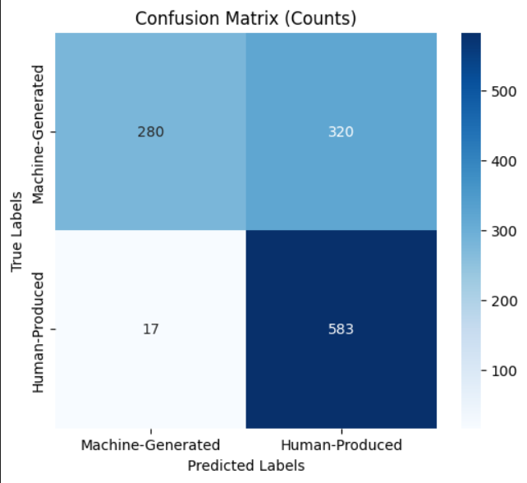
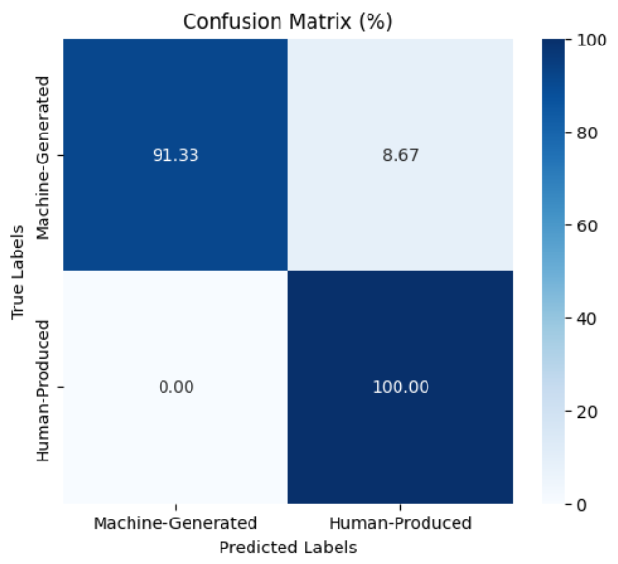
Pretrained Model
Coher Dataset
Finetuned Model
Coher Dataset

Slide 4
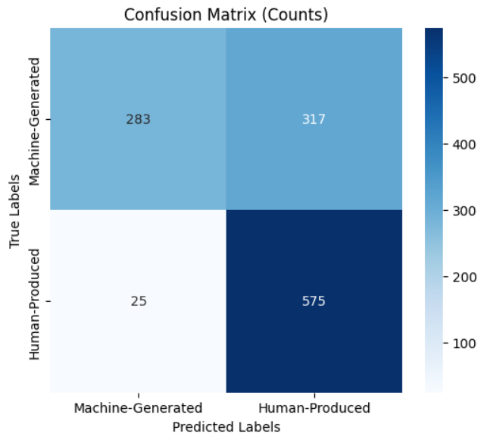
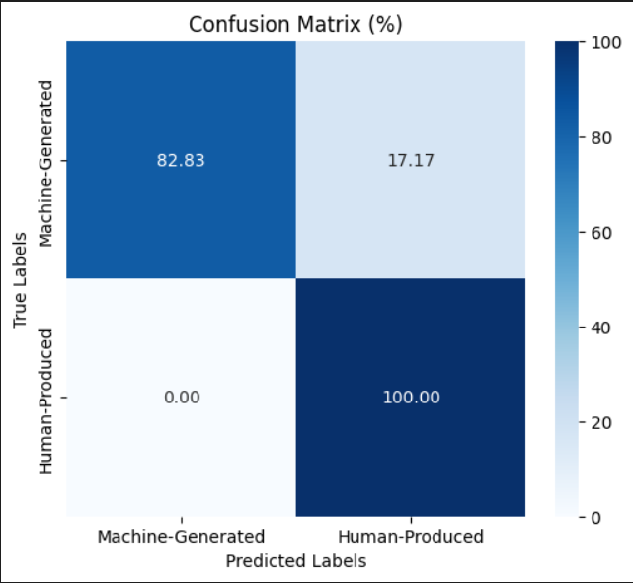
Pretrained Model
Davinci Dataset
Finetuned Model
Davinci Dataset

Slide 5
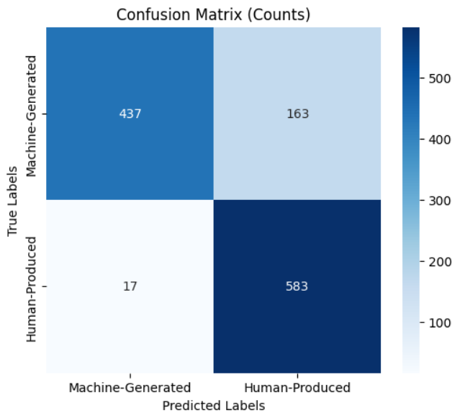
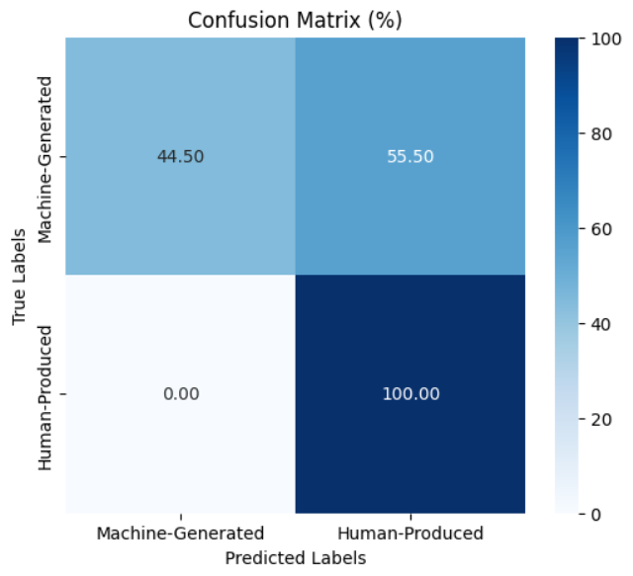
Pretrained Model
Flant Dataset
Finetuned Model
Flant Dataset

Slide 6
ML DATASET

Slide 7
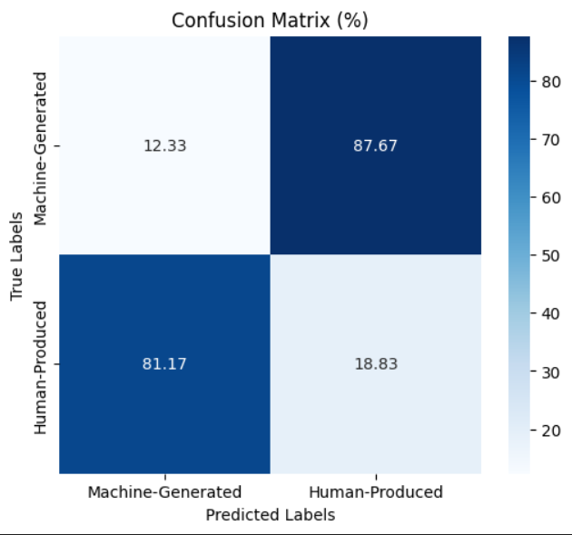
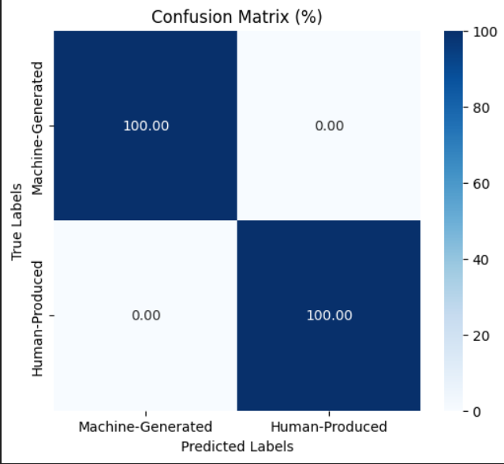
Fine Tuned with ARXIV
Wiki Dataset
Fine Tuned with ARXIV & ML
Wiki Dataset

Slide 8
WIKI DATASET

Slide 9
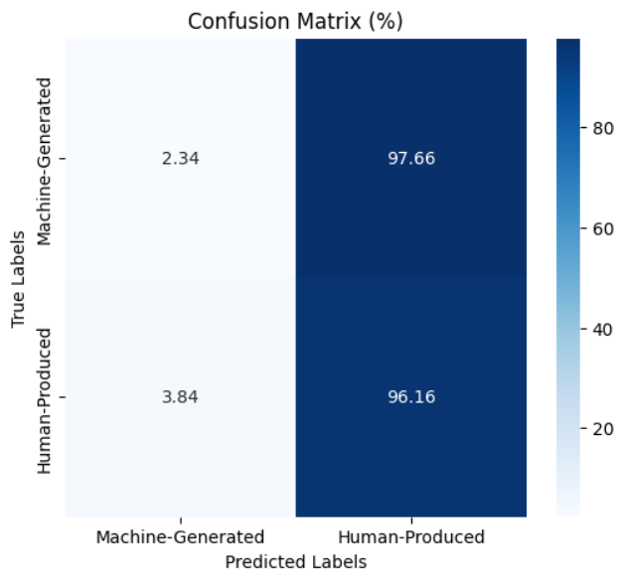

Fine Tuned with ARXIV & ML
Chat gpt Dataset
Fine Tuned with ARXIV & ML & Wiki
Chat gpt Dataset

Slide 10
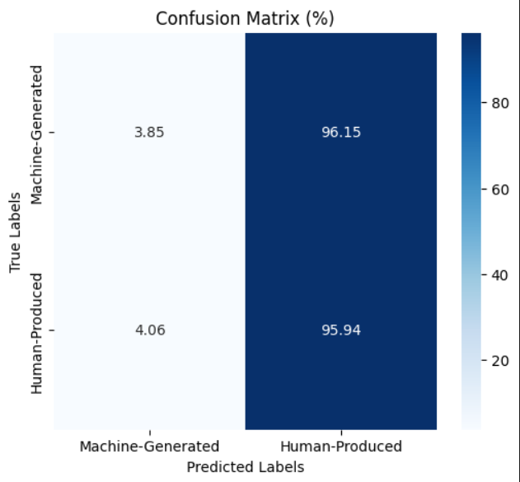
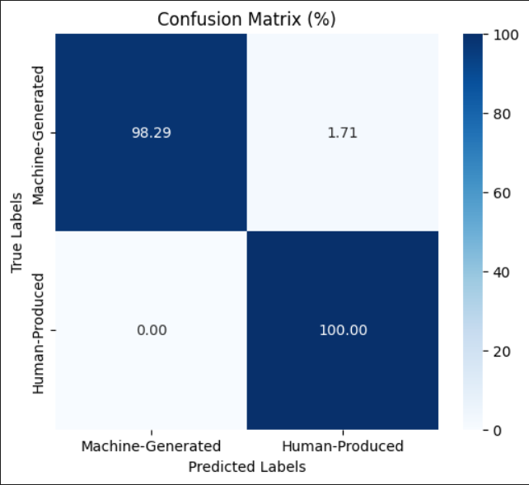
Fine Tuned with ARXIV & ML
CoherDataset
Fine Tuned with ARXIV & ML & Wiki
Coher Dataset

Slide 11
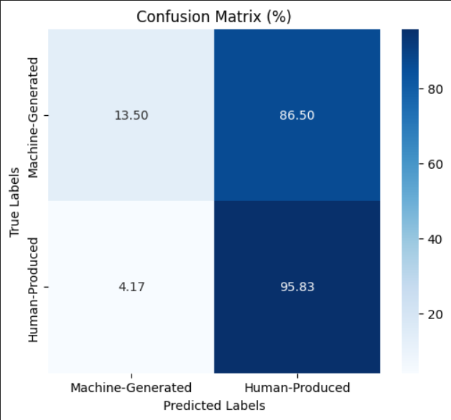
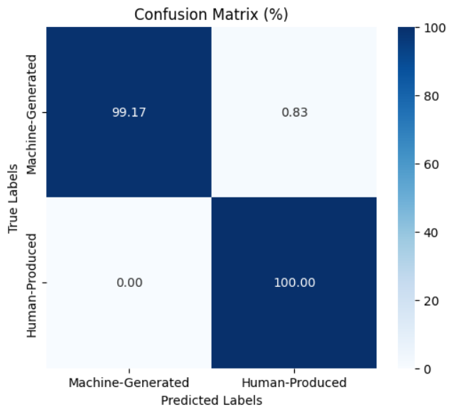
Fine Tuned with ARXIV & ML
Davinci Dataset
Fine Tuned with ARXIV & ML & Wiki
Davinci Dataset

Slide 12
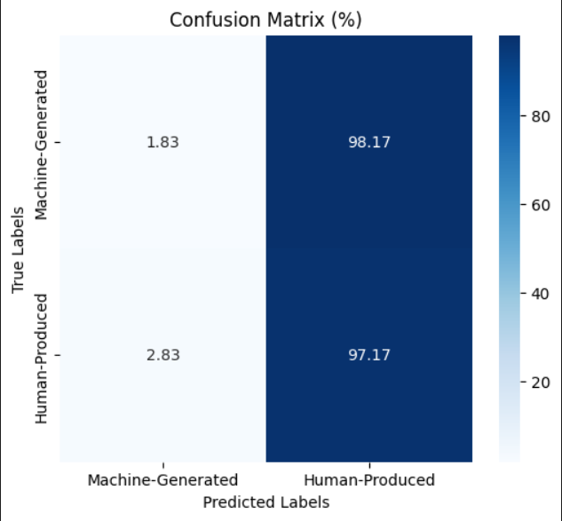
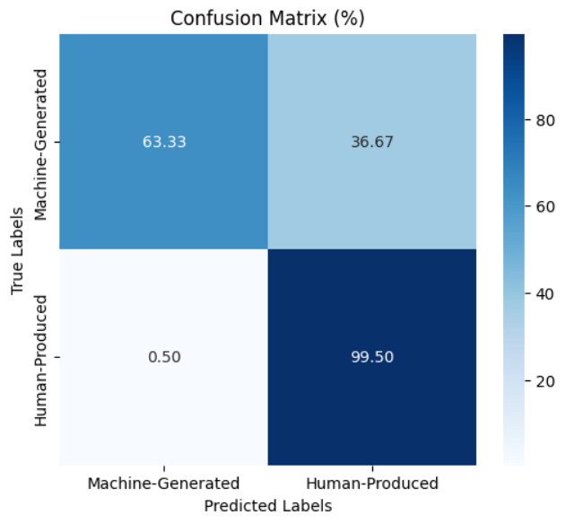
Fine Tuned with ARXIV & ML
Bloomz Dataset
Fine Tuned with ARXIV & ML & Wiki
Bloomz Dataset

